Slide 1
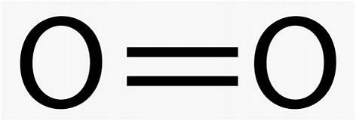
Recap
resonance
O O
Satisfies octet rule; Maybe weight this 60%
Almost satisfies octet rule;
Consistent with magnet experiment;
Maybe weight this 40%
resonance
Satisfies octet rule; Weight this 50%
Satisfies octet rule; Weight this 50%

Slide 2
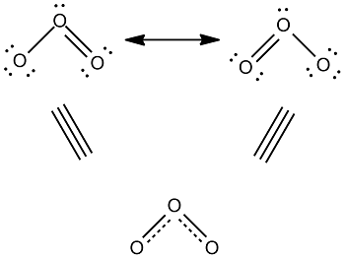
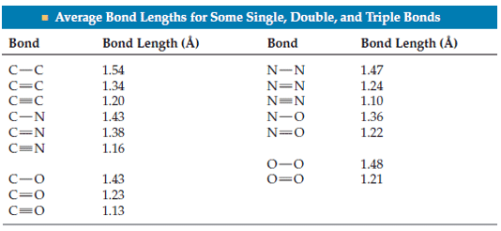
Recap
Resonance-average bond lengths
Prediction: Bond length between typical single and double bonds
Observation: Bond length = 1.3 Å.

Slide 3
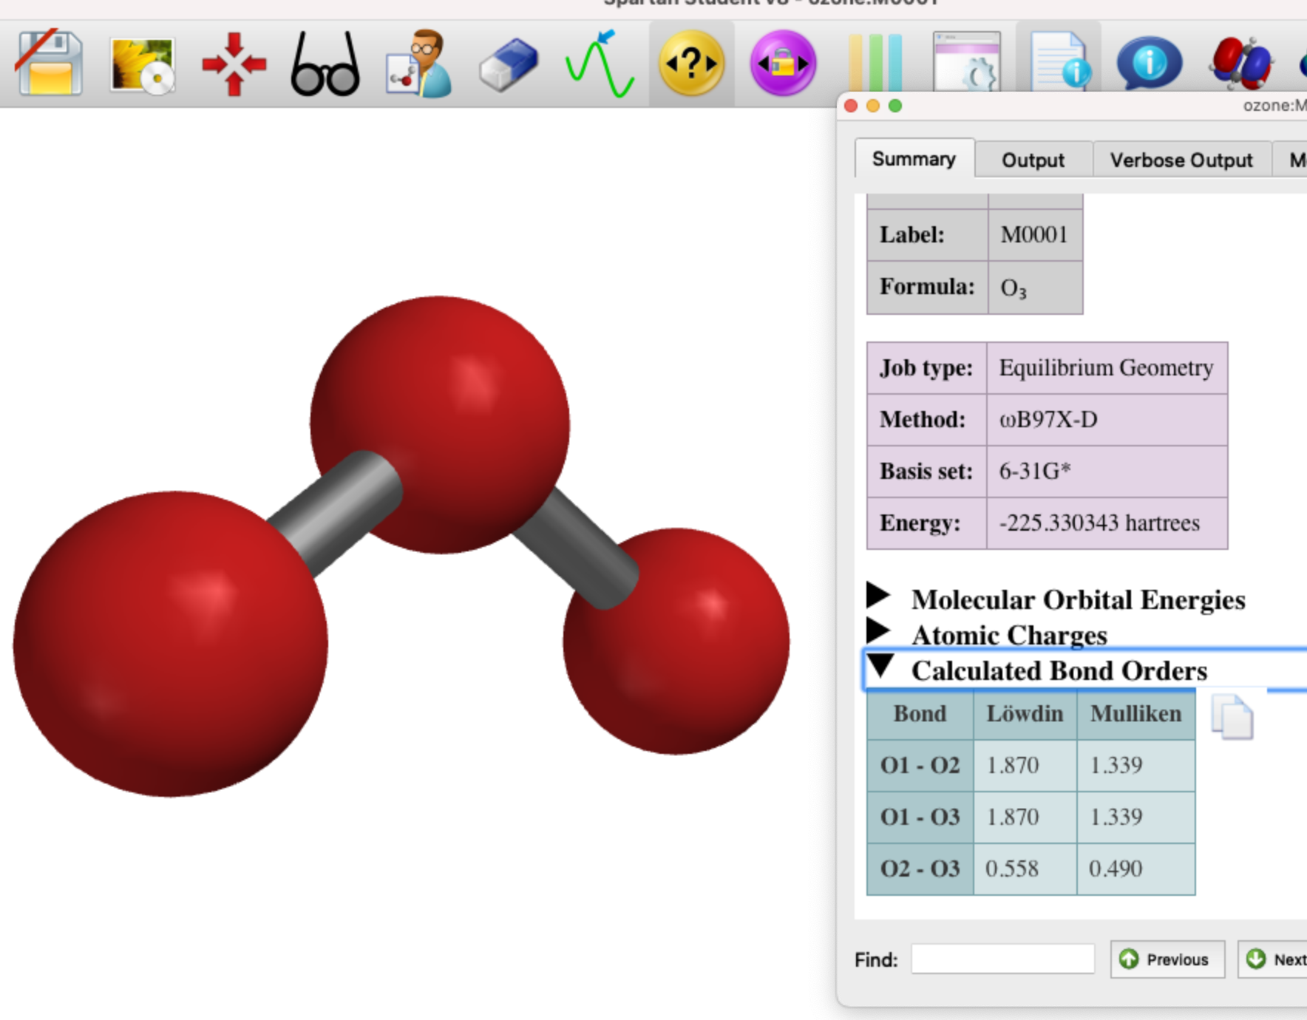
Recap
1
2
2
1
1.5
1.5
Resonance-averaged bond orders
Prediction: Bond order should be around 1.5.
Observation (according to Spartan): Mulliken bond order = 1.34.

Slide 4
X-Y-Z delocalization and allylic lone pairs
X
Y
Z
Electrons written above Z are called an allylic lone pair

Slide 5
X-Y-Z delocalization and allylic lone pairs
X
Y
Z
X
Y
Z
X
Y
Z

Slide 6
X-Y-Z delocalization and allylic lone pairs
X
Y
Z
X
Y
Z
Electrons written above X are now the allylic lone pair
X
Y
Z

Slide 7
X-Y-Z delocalization and allylic lone pairs
X
Y
Z
This restores the starting electron configuration
We say those electrons (four in all) are delocalized across the entire molecule
X
Y
Z
X
Y
Z
X
Y
Z

Slide 8
X-Y-Z delocalization and allylic lone pairs written as resonance forms
X
Y
Z
X
Y
Z

Slide 9
X-Y-Z delocalization and allylic lone pairs written as resonance forms
X
Y
Z
X
Y
Z

Slide 10
X-Y-Z delocalization and allylic lone pairs
X-Y-Z delocalization and allylic lone pairs written as resonance forms
X
Y
Z
resonance
X
Y
Z

Slide 11
X-Y-Z delocalization and allylic lone pairs
X-Y-Z delocalization and allylic lone pairs written as resonance forms
X
Y
Z
resonance
X
Y
Z
resonance

Slide 12
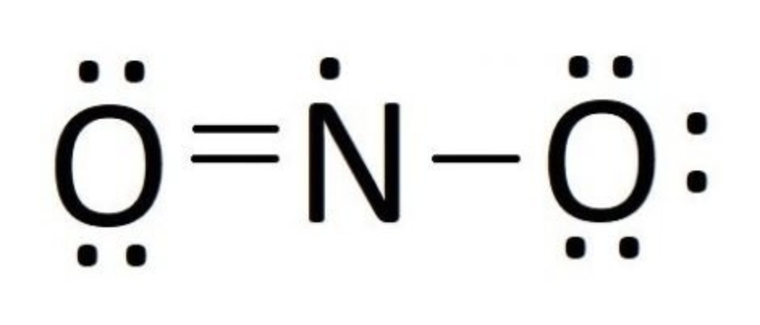
Trying your skill with NO₂
What are the expected equivalent alternative resonance forms?
What weights would you assign to each resonance form?
Do any resonance forms lead you to believe NO₂ would be attracted to a magnet?
What would you expect the bond length of each N-O bond to be?
What does Spartan say the bond length of each N-O bond is?
What would you expect the bond order of each N-O bond to be?
What does Spartan say the (Mulliken) bond order is?

Slide 13
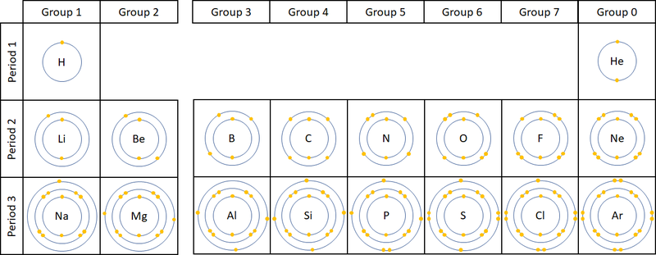
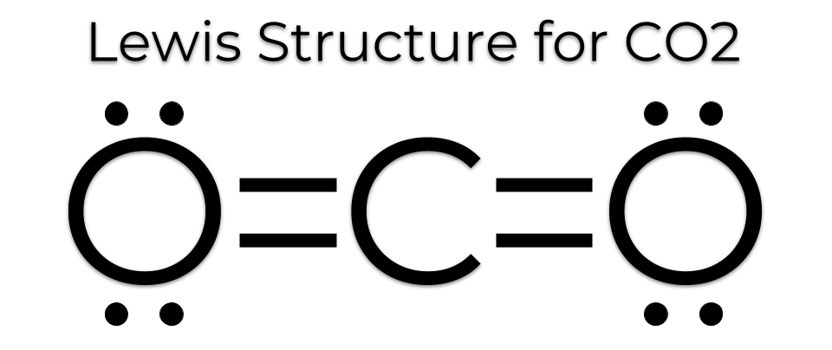
Formal charges
Video recap
FC = #valence - #claimed

Slide 14
Formal charges
Video recap
FC = #valence - #claimed
(0)
(0)
(0)

Slide 15
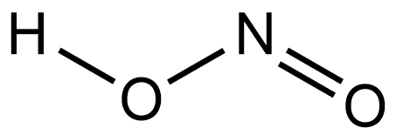
Practice …

Slide 16
Practice …

Slide 17
Practice …
All atoms have FC = 0

Slide 18
Practice …
O

Slide 19
Practice …
(-1)
O
(0)
(+1)
(0)
(0)

Slide 20
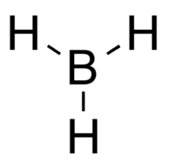
Practice …
In some cases, it’s appropriate to make sure you have the right number of electrons. Here’s a tip: add up all the FC’s, should get the net charge on the molecule (zero unless otherwise indicated).

Slide 21
Practice …
In some cases, it’s appropriate to make sure you have the right number of electrons. Here’s a tip: add up all the FC’s, should get the net charge on the molecule (zero unless otherwise indicated).
All atoms have FC = 0, add up to zero net charge. Great!

Slide 22
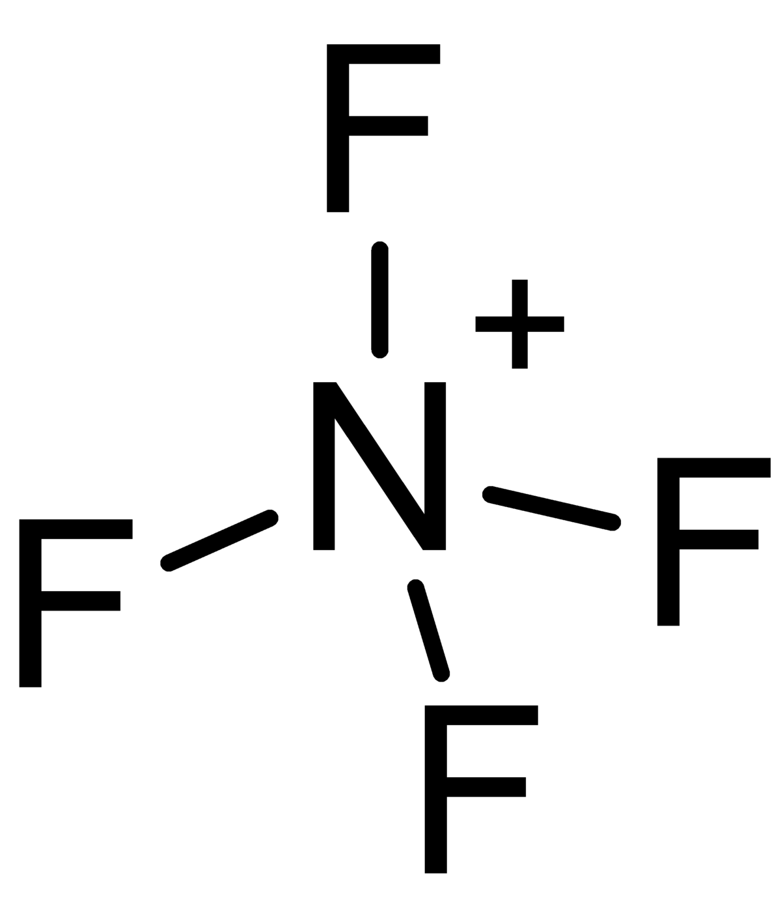

Practice …
In some cases, it’s appropriate to make sure you have the right number of electrons. Here’s a tip: add up all the FC’s, should get the net charge on the molecule (zero unless otherwise indicated).
All atoms have FC = 0 except N, which has FC = +1. Predict this molecule is actually a cation with +1 net charge.

Slide 23
Practice …
+1
In some cases, it’s appropriate to make sure you have the right number of electrons. Here’s a tip: add up all the FC’s, should get the net charge on the molecule (zero unless otherwise indicated).
All atoms have FC = 0 except N, which has FC = +1. Predict this molecule is actually a cation with +1 net charge.

Slide 24
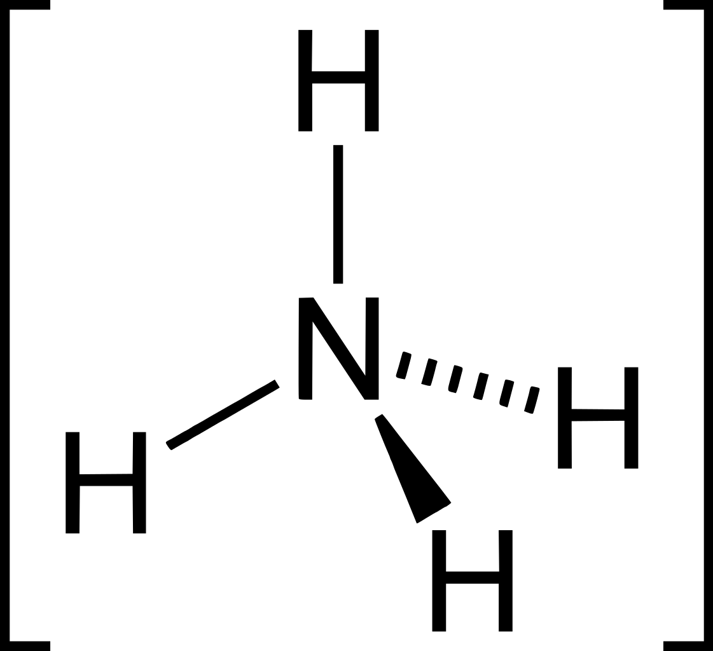
Practice …
Charge?

Slide 25
Practice …
+1
All atoms have FC = 0 except N, which has FC = +1. We’d predict this molecule is actually a cation with +1 net charge.

Slide 26
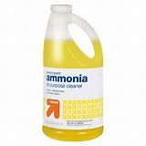
Practice …
+1
This is called the ammonium ion. It’s a component of commercial cleaning agents labeled “ammonia.”
All atoms have FC = 0 except N, which has FC = +1. We’d predict this molecule is actually a cation with +1 net charge.

Slide 27
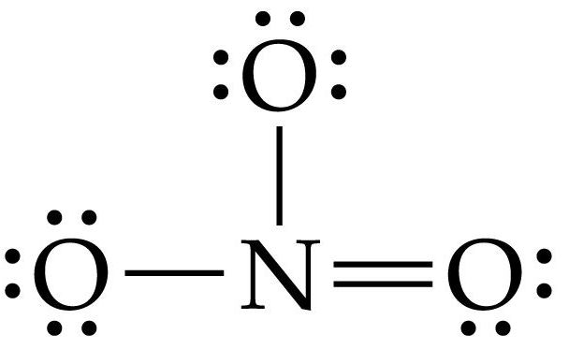
Practice …
Charge?

Slide 28
Practice …
(-1)
-1
(0)
(+1)
(-1)
We’d predict this molecule is an anion with -1 net charge.

Slide 29
Formal charges when there’s equally-weighted resonance
What are the formal charges on atoms in each resonance form?
What are the resonance-averaged formal charges?

Slide 30
Formal charges when there’s equally-weighted resonance
(+1)
(+1)
What are the formal charges on atoms in each resonance form?
(-1)
(0)
(0)
(-1)
What are the resonance-averaged formal charges?

Slide 31
Formal charges when there’s equally-weighted resonance
(+1)
(+1)
What are the formal charges on atoms in each resonance form?
(-1)
(0)
(0)
(-1)
(+1)
(-.5)
(-.5)
What are the resonance-averaged formal charges?

